Slide 1
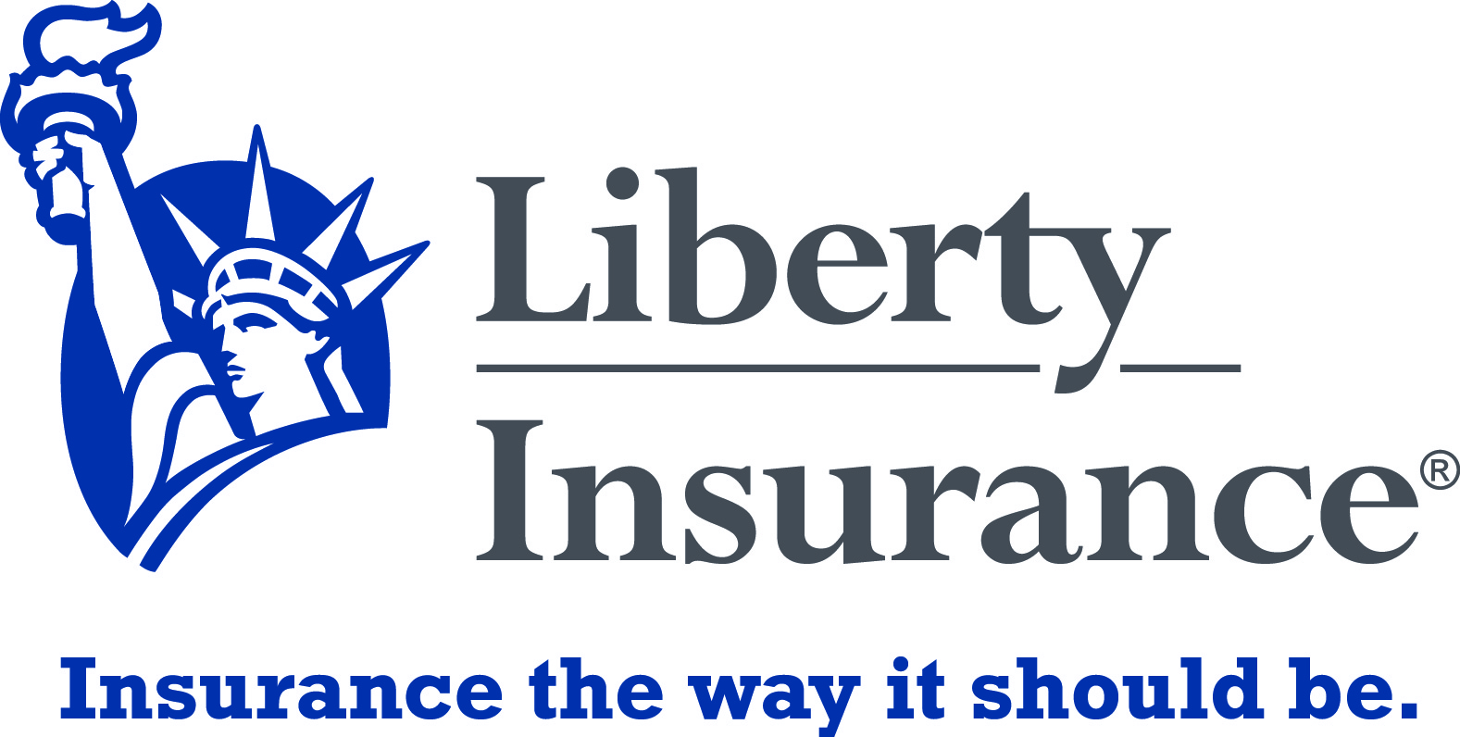

Slide 2
WELCOME
Insurance Ireland
Investigation of Employers & Public Liability Claims & Fraud from an Underwriting Perspective.
1 Hour CPD by Wayne Kennedy, Claims Manager

Slide 3
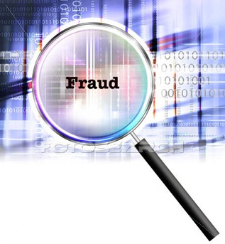
Dealing with Fraud from an Underwriting perspective
Good underwriting practices by their very nature will look to minimise the risk of fraud
From a Commercial perspective our main concern is fraudulent or exaggerated claims
When should Underwriters be vigilant?
Quoting
Incepting
Completing Mid-Term Adjustments

Slide 4
Dealing with Fraud from an Underwriting perspective – 4 Key Checks
Financial checks
Unsatisfied Court Judgements
Late filing of accounts
Poor financials over a sustained period of time
Assets liquid or fixed / Lack of assets
Outstanding loans
Embellished asset values
Company checks
Background checks and profiling on company Directors to identify any issues:
Other company interests
Number of Directorships
Conflicts of interest
Prosecutions
Tax clearance certificates
Openness of the company to provide information on their business operation
Evidence of strong HR involvement
Transient nature of staff
Market Information / Company Knowledge
Internet checks
Quality of information presented
Nature of the clients customers
Nature of the trade sector- Example Retail (Wrongful Arrest) / Increased moral hazard in Nightclubs / Casinos
Location of the risk
Claims history
Duplicate or multiple policies
Surveys
Pre-quote or post-bind surveys are a great way of identifying the potential for fraud
Our surveyor will look for good practices regarding Health & Safety, Training, Cash Handling and physical security which will help mitigate any fraudulent activity.
Checks can also be carried out on individuals

Slide 5
In Conclusion
In essence ‘gut feeling’ backed up with objective assessment will generally serve to identify either inconsistencies in the information being provided, or inaccuracies which may in turn lead to concerns over the suitability of the risk for cover.
More forensic ways of interrogating company accounts and information may be considered, however in the context of risk profiling for insurance covers these may prove time-consuming and costly.
The many guises of Insurance Fraud have one common effect – they increase the cost of claims for insurance companies – and this in turn increases premiums for policyholders

Slide 6
Public & Employers Liability Insurance
Employers’ liability insurance protects the legal liability of the employer for bodily injury or illness or death or disease sustained by an employee that arises out of and in the course of their employment.
Public liability insurance protects the legal liability of the insured for both bodily injury (which includes death, illness or disease), and for any loss of or damage to property which happens in connection with the business insured.

Slide 7
The Liability Market
In 2012 Employers and Public liability insurance accounted for €410 million in G.W.P, approximately 17% of all G.W.P. (Insurance Ireland 2012 Fact file).
Of this, €335 million was net earned premium.
With approximately 18,500 new claims being notified in 2012, this lead to a net underwriting loss of approximately €142 million for all insurers writing business in Ireland.

Slide 8
Impacts Of Net Underwriting Loss
Impact Of Net Underwriting Loss.
Insurers withdraw from the market altogether.
Difficult to obtain liability cover in an ever changing market.
Increase in premium for business owners.
Insurers withdraw offering Liability Insurance in high risk areas.

Slide 9
What Can Businesses Do?
Counter Measures To Impact Of Loss.
Better risk management by business owners thereby reducing the number of claims.
Partner with insurers to provide training in risk awareness and programmes to educate their staff in the claims process.
Business owners being more active in claim prevention techniques and ensuring staff buy in to the process.

Slide 10
Why Do People Make A Claim?
Genuine injury sustained.
Exaggeration & Fraud.
Costs have been incurred (medical / physiotherapy).
Financial pressures (current economic climate).
Increased awareness (Injuriesboard.ie & advertising)
Peer pressure.
Grievance with employer.
Employee has been laid off.

Slide 11
Types Of Public Liability Claims
Defective Products / Foodstuffs.
Slip, Trip & Fall.
Assault.
Defamation.
Property Damage.

Slide 12
Types Of Employers Liability Claims
Workplace Diseases.
Slip, Trip & Fall.
Falls From Heights.
Injuries Caused By Use Of Machinery.
Repetitive Strain Type Injuries.

Slide 13
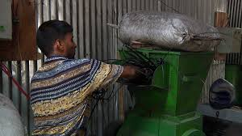

Slide 14
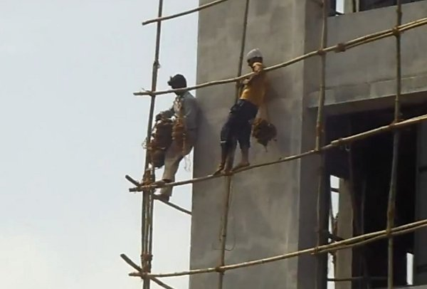

Slide 15
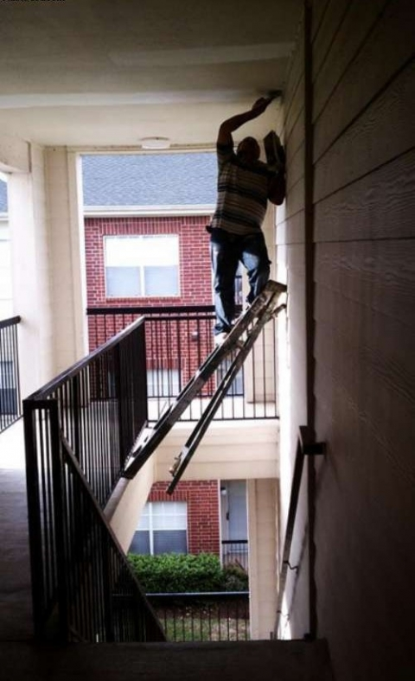

Slide 16
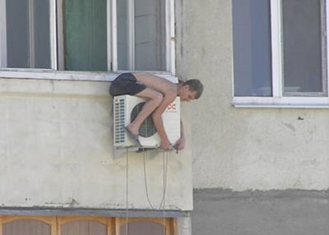

Slide 17
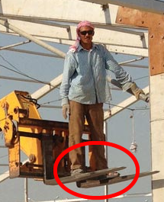

Slide 18
Statutory Duties.
In Ireland the Oireachtas has, by legislation created duties that are known as statutory duties or rules that must be adhered to. Legislation Imposing Statutory Duties.
Employers Liability.
-The Factories Act 1955
-The Safety, Health & Welfare At Work Act 2005
-The Safety, Health & Welfare At Work (General Application) Regulations 2007
-The Safety, Health & Welfare at Work (Construction) Regulations 2006
Public Liability.
-The Occupiers’ Liability Act 1995

Slide 19
Liability Insurance & The Law.
Most if not all actions taken as a result of third party insurance claims will allege a breach of statutory duty and negligence in the legal proceedings.
The onus of proof is on the plaintiff to prove that breach of duty and negligence but in some instances the defendant is their own worst enemy due to the lack of investigation carried out when first notified of the incident that gave rise to the claim.
To successfully defend any action where a breach of statutory duty or negligence will potentially be alleged it is imperative that the insurers are notified at the earliest opportunity in order for them to assist, advise and represent as their experience will be invaluable to the insured when dealing with this type of incident.

Slide 20
Liability Insurance & The Law.
The relationship between the Law of Torts & Insurance is very close.
The Law of Torts imposes obligations and it regulates the conduct of people in their dealings with one another.
A wrongdoer can be found liable under the Law of Torts due to negligence, trespass, defamation & nuisance.
In legal terms the word “liability” means anything that puts a person or legal entity at a disadvantage.
Legal liability is where the wrongdoer is held liable by the legal process and the claimant is entitled to a remedy from the wrongdoer i.e. monetary compensation.

Slide 21
The Tort Of Negligence.
Negligence is the tort most often encountered in third party insurance claims.
To succeed in an action for breach of statutory duty the plaintiff must establish;
The statute was intended by the Oireachtas to allow a civil law remedy.
The statute must impose a duty on the defendant.
The plaintiff must prove that the statutory duty was owed to them.
There must be a breach of the duty by the defendant.
The damage suffered by the plaintiff must be caused by the breach and be of the sort that was contemplated by the statute.

Slide 22
Incident Investigation.
When an incident occurs the insured will not have the benefit of having the insurance company on site and therefore the initial investigation becomes their responsibility.
The most important immediate task is the medical treatment of the injured, and prevention of further injuries have priority, others must not interfere with these activities. When these matters are under control, the investigators can start their work.
It cannot be stressed how important the initial incident investigation is to the claims process, as it will be the foundation to the investigation that will be carried out by the insurers claims representative.

Slide 23
Benefits Of An Early Investigation.
Factual Information Obtained.
Early Decision On Liability.
Better Chance Of Avoiding The Legal Route.
Speedy & Cost Effective Settlements Where Liable.

Slide 24
Consequences Of A Late Investigation.
Possible indemnity issues.
Delay In Ascertaining Liability.
Possible Loss Of Critical Factual Information.
Delay In Achieving Settlements.
Greater Risk Of Litigation.
Greater Cost Of Settlement.

Slide 25
Key Steps Involved In Incident Investigations.
Gather All Applicable Information.
Analyze The Information.
Draw Conclusions From The Information.
Make Recommendations.

Slide 26
Physical Evidence.
Before attempting to gather information, examine the site for a quick overview, take steps to preserve evidence, and identify all witnesses. Physical evidence is probably the most non-controversial information available. It is also subject to rapid change or obliteration; therefore, it should be the first to be recorded.
You may also want to take photographs before anything is moved, both of the general area and specific items. Later careful study of these may reveal conditions or observations missed previously. Broken equipment, debris, and samples of materials involved should be retained for further analysis by appropriate experts. Even if photographs are taken, written notes about the location of these items at the accident scene should be prepared.

Slide 27
Witness Accounts.
Although there may be occasions when you are unable to do so, every effort should be made to interview witnesses. In some situations witnesses may be your primary source of information because you may be called upon to investigate an accident without being able to examine the scene immediately after the event. Because witnesses may be under severe emotional stress or afraid to be completely open for fear of recrimination, interviewing witnesses is probably the hardest task facing an investigator.
Witnesses should ideally be kept apart and interviewed as soon as possible after the accident. If witnesses have an opportunity to discuss the event among themselves, individual perceptions may be lost in the normal process of accepting a consensus view where doubt exists about the facts.
Witnesses should be interviewed alone, rather than in a group. You may decide to interview a witness at the scene of the accident where it is easier to establish the positions of each person involved and to obtain a description of the events. On the other hand, it may be preferable to carry out interviews in a quiet office where there will be fewer distractions. The decision may depend in part on the nature of the accident and the mental state of the witnesses.

Slide 28
Witness Accounts.
The purpose of the interview is to establish an understanding with the injured party / witness and to obtain his or her own words describing the event:
DO...
Put the injured party / witness, who is probably upset, at ease.
Emphasize the real reason for the investigation, to determine what happened and why.
Let the witness talk, listen.
Confirm that you have the sequence of events correct.
Try to sense any underlying feelings of the witness and take note of demeanor i.e alcohol.
Make short notes or ask someone else on the team to take them during the interview.
Close on a positive note.
DO NOT...
Intimidate the witness.
Interrupt.
Prompt.
Ask leading questions.
Show your own emotions.
Jump to conclusions.

Slide 29
Essential Information Required in Incident Investigations.
CCTV footage of the date of the incident is preserved (all cameras).
Incident report is completed on the day / night of the incident containing;
- Time, Date and Location of Incident.
- Exact details of Incident.
- Who was involved? Employee; Member of Public, Sub Contractor.
- Relevant Details (I.e. Name, Address, Contact No.).
- Make a sketch or take a photograph of scene.
- Record time missed from Work; Is injured party being paid?
- Get Witness Details (I.e. Name, Address, Contact No.).
- Record Nature of injuries & Whether Ambulance Was Called.

Slide 30
Essential Information Required in Incident Investigations.
-Position of injured party.
-What type of footwear / clothing was the injured party wearing (if incident is slip or fall).
-Equipment being used at time of incident.
-Materials or chemicals being used at time of incident.
-Safety devices in use.
-Position of appropriate security guards.
-Damage to area in vicinity of incident.
-Housekeeping of area.
-Weather conditions.
-Lighting levels.
-Noise levels.
-Records of who was involved in preparation of foodstuffs, e.g. Washing, defrosting and cooking.
-PSA licenses for security staff.
-Weather conditions (NB Access / Egress).
-Occasion that brought claimant to premises.
-Staff Rosters For Day Of Incident.
-All Cleaning & Maintenance Records.
-All Risk Assessments & Method Statements.
-Accident Book.
-All training records.
-Witness Accounts

Slide 31
Liability Section 26 Case Law.
Mohammed Sameur Rahman -v- Craigfort Taverns Limited
Alan Danagher -v- Glantine Inns Limited
Smith -v- Health Service Executive

Slide 32
Questions?

Slide 33
THANK YOU

